Slide 1
COM521 Ethical Hacking and Pen testing – iLabs
CEH v12 Module 12: Evading IDS, Firewalls, and Honeypots

Slide 2
Lab 1: Perform Intrusion Detection using Various Tools
Lab Objectives
Detect intrusions using Snort
Detect malicious network traffic using ZoneAlarm FREE FIREWALL
Detect malicious network traffic using HoneyBOT

Slide 3

SNORT
Uses of Snort:
Snort is an open-source network intrusion detection system
Straight packet sniffer such as tcpdump
Packet logger (useful for network traffic debugging, etc.)
Network intrusion prevention system
Notes:
Snort is an open-source network intrusion detection system, capable of performing real-time traffic analysis and packet logging on IP networks. It can perform protocol analysis and content searching/matching and is used to detect a variety of attacks and probes such as buffer overflows, stealth port scans, CGI attacks, SMB probes, and OS fingerprinting attempts. It uses a flexible rules language to describe traffic to collect or pass, as well as a detection engine that utilizes a nort is an open-source network intrusion detection system, capable of performing real-time traffic analysis and packet logging on IP networks. It can perform protocol analysis and content searching/matching and is used to detect a variety of attacks and probes such as buffer overflows, stealth port scans, CGI attacks, SMB probes, and OS fingerprinting attempts. It uses a flexible rules language to describe traffic to collect or pass, as well as a detection engine that utilizes a modular plug-in architecture.Smodular plug-in architecture.

Slide 4
Tasks
Install Snort
Copy the so_rules folder in the SNORT folder
Copy the preproc_rules folder into SNORT Folder
Run SNORT
snort -W. This command lists your machine’s physical address, IP address, and Ethernet Drivers,
enable the Ethernet Driver, in the command prompt, type snort -dev -i 1

Slide 5
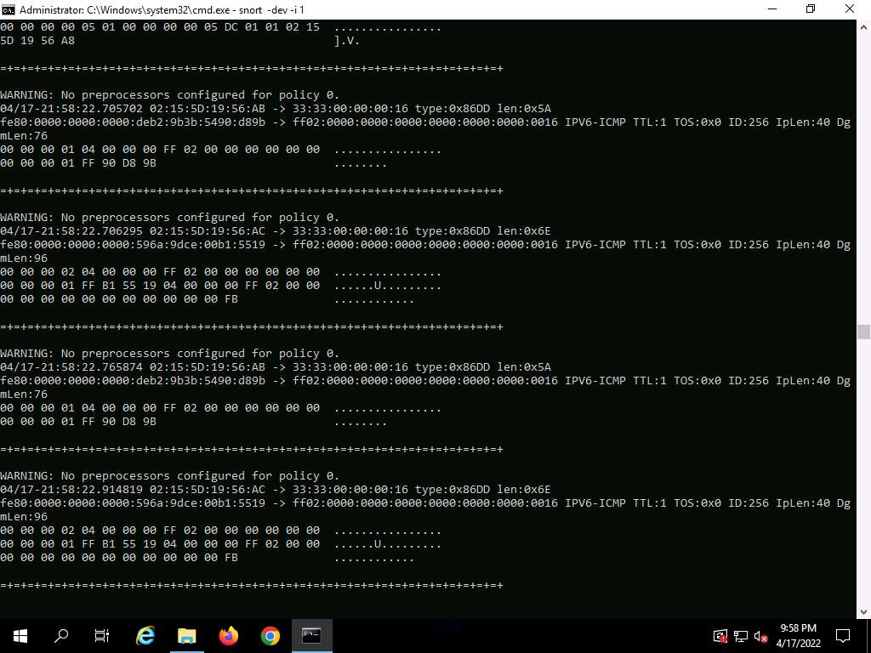
Snort Network Capture
ou see a rapid scroll text in the command prompt, which means that the Ethernet Driver is enabled and working properly
type ping google.com
This ping command triggers a Snort alert in the Snort command prompt with rapid scrolling text..

Slide 6
Tasks (Continued)
white_list and black_list and change their file extensions from .txt to .rules.
Add an alert to the rules file
Run snort with the following command:
snort -iX -A console -c C:\Snort\etc\snort.conf -l C:\Snort\log -K asc where X is the interface ID
Ping from an Attacker machine :
ping 10.10.1.19 -t from the Attacker Machine
Observe that Snort triggers an alarm, as shown in the screenshot:

Slide 7
alert icmp $EXTERNAL_NET any -> $HOME_NET 10.10.1.19 (msg:"ICMP-INFO PING"; icode:0; itype:8; reference:arachnids,135; reference:cve,1999-0265; classtype:bad-unknown; sid:472; rev:7;)
Action: alert
The rule's action is to generate an alert when traffic matches the rule.
Protocol: icmp
The rule applies to Internet Control Message Protocol (ICMP) traffic.
Source IP and Port: $EXTERNAL_NET any
This indicates that the source IP address is any address in the external network ($EXTERNAL_NET). The source port is any, which makes sense since ICMP doesn't use ports like TCP/UDP.
Destination IP and Port: $HOME_NET 10.10.1.19
The destination is the internal network ($HOME_NET), specifically the IP address 10.10.1.19.
Message: msg:"ICMP-INFO PING"
When the rule is triggered, the message that appears in the alert is "ICMP-INFO PING". This indicates that the alert pertains to a ping or ICMP request.
Notes:
This SNORT rule generates an alert for an ICMP Echo Request (ping) originating from any external network and targeting the specific internal IP address 10.10.1.19. The rule is classified as potentially dangerous (bad-unknown) and references known vulnerabilities related to ping/ICMP behavior, such as CVE-1999-0265, which is related to certain ICMP-based attacks.

Slide 8
alert icmp $EXTERNAL_NET any -> $HOME_NET 10.10.1.19 (msg:"ICMP-INFO PING"; icode:0; itype:8; reference:arachnids,135; reference:cve,1999-0265; classtype:bad-unknown; sid:472; rev:7;)
ICMP Code (icode): icode:0
This specifies that the ICMP code (ICMP Echo Reply) must be 0.
ICMP Type (itype): itype:8
This defines the ICMP type as 8, which corresponds to an ICMP Echo Request (i.e., a ping request).
Reference: reference:arachnids,135 and reference:cve,1999-0265
These are external references. arachnids,135 refers to a specific rule in the Arachnids rule set, and cve,1999-0265 refers to a Common Vulnerabilities and Exposures (CVE) entry that relates to this type of attack.
Classification (classtype): bad-unknown
The classtype field classifies the alert. Here, it is categorized as bad-unknown, indicating that the traffic is potentially harmful but its exact nature is unclear.
Signature ID (sid): sid:472
This is the unique ID of the rule in the SNORT rule database.
Revision (rev): rev:7
This is the revision number of the rule, indicating that this is the 7th revision of rule sid:472.

Slide 9
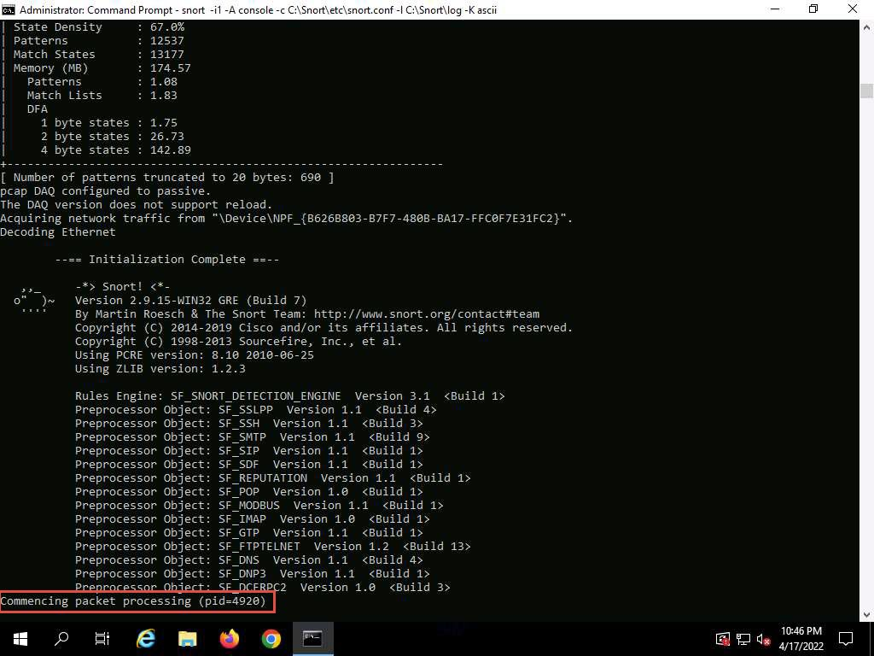
Running Snort
Commencing packet processing (pid=xxxx) (the value of xxxx may be any number; in this task, it is 5384), as shown in the screenshot.

Slide 10
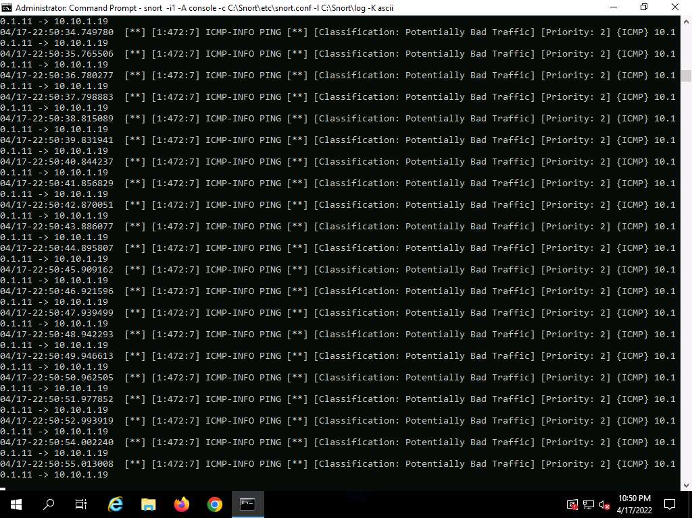
Conclusion
This means that whenever an attacker attempts to connect or communicate with the machine, Snort immediately triggers an alarm
This will make you aware of the intrusion and can thus take certain security measures to disconnect the lines of communication with the attacker’s machine.
Reflection :
How can attackers modify their techniques to evade SNORT detection, and what changes can be made to SNORT configurations or rules to improve detection of these evasion methods?
Notes:
This reflection question prompts critical thinking about both the offensive and defensive aspects of network security:
Offensive Aspect: The attacker’s perspective on evading IDS systems using techniques such as traffic obfuscation, packet fragmentation, or protocol manipulation.
Defensive Aspect: The defender's approach to enhancing IDS configurations, modifying rules, and applying new methods to detect and block sophisticated attack vectors.
Reflection Question:
"How can attackers modify their techniques to evade SNORT detection, and what changes can be made to SNORT configurations or rules to improve detection of these evasion methods?"
Model Answer:
Attackers can use a variety of techniques to evade detection by SNORT, including:
Packet Fragmentation:
Attackers can split malicious payloads into smaller fragments that individually may not match any predefined SNORT rules. Since SNORT often analyzes packets at the IP layer, this can make detection harder if the IDS is not set up to reassemble fragmented packets.
Payload Obfuscation:
This involves altering the payload in a way that makes it harder for signature-based systems to detect. For instance, attackers can use encoding or encryption to conceal malicious content within network traffic.
Protocol or Port Evasion:
Attackers may send malicious traffic over non-standard ports (e.g., using port 80, normally associated with HTTP, for attacks not related to web traffic) or even within protocols that are not often scrutinized by SNORT.
Timing Attacks:
Instead of bombarding a system with traffic, attackers can space out their malicious activity over time to avoid triggering rate-based detection systems.
Use of Tunneling:
Attackers may tunnel malicious traffic within allowed protocols like DNS or HTTP, where SNORT signatures may not cover every scenario of abuse within such protocols.
Defensive Strategies for SNORT Configuration:
To counter these evasion techniques, network defenders can adjust SNORT configurations as follows:
Enable Preprocessors:
Use SNORT’s preprocessors, such as the frag3 preprocessor for packet reassembly, to detect attacks that rely on fragmentation. This allows SNORT to reconstruct fragmented packets and inspect the full payload for malicious content.
Custom Rule Tuning:
Adjust rules to include detection of non-standard port usage and more advanced inspection criteria. For example, instead of just detecting traffic on known ports (80 for HTTP, 443 for HTTPS), create rules that monitor for unexpected traffic types on these ports.
Deep Packet Inspection:
Utilize deep packet inspection (DPI) to analyze the contents of a packet beyond just its headers. This can help detect malicious payloads, even when they are obscured or fragmented.
Traffic Anomaly Detection:
Configure SNORT to also perform anomaly detection in addition to signature-based detection. This approach looks for deviations from baseline normal traffic, which can help detect novel or zero-day attack methods that haven’t yet been captured by predefined signatures.
Frequent Updates to Rule Sets:
Regularly update SNORT’s rule sets from sources like Emerging Threats or the SNORT community, which provides new signatures to detect the latest techniques used by attackers.
Monitor Encrypted Traffic:
While SNORT may not be able to decrypt encrypted traffic directly, it is still important to monitor the traffic patterns (e.g., abnormal SSL handshakes) to detect any irregularities in encrypted channels, which could indicate tunneling or other forms of evasion.
By understanding both the methods attackers use to evade detection and the defensive strategies that SNORT can employ to mitigate these techniques, security teams can significantly enhance their network’s security posture.

